Slide 1
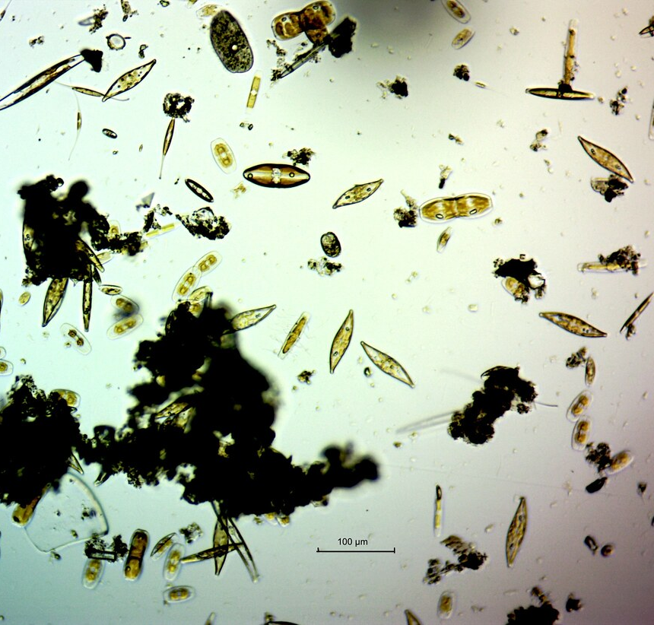
Vertical migration of diatoms
BIOL 3111
Gabriela Feres, Liza Kamtchatnova, Paige Stuart and Sarah Postuma
https://www.flickr.com/photos/76798465@N00/27995935284
Notes:
Hi everyone! We're the mud group and we'll be presenting the vertical migration of diatoms.

Slide 2
Presentation Outline
Motivations – Why did we do this?
Methods
Mudflat simulation
Chlorophyll levels
Manual cell count
Results
Did vertical migration take place in every condition?
What types of cells were preforming this migration?
Conclusion – What does all this mean?
Notes:
We have several different parts to our project, so here is a short outline. We'll begin with the motivations and inspiration behind our project. Next, we'll cover methods. We'll state how we set up our mud flat simulation then how we went about our chlorophyll analyses and our manual cell count. Our results answer whether vertical migration took place over each condition and what types of cells were preforming this action. We'll finish off with a conclusion.

Slide 3
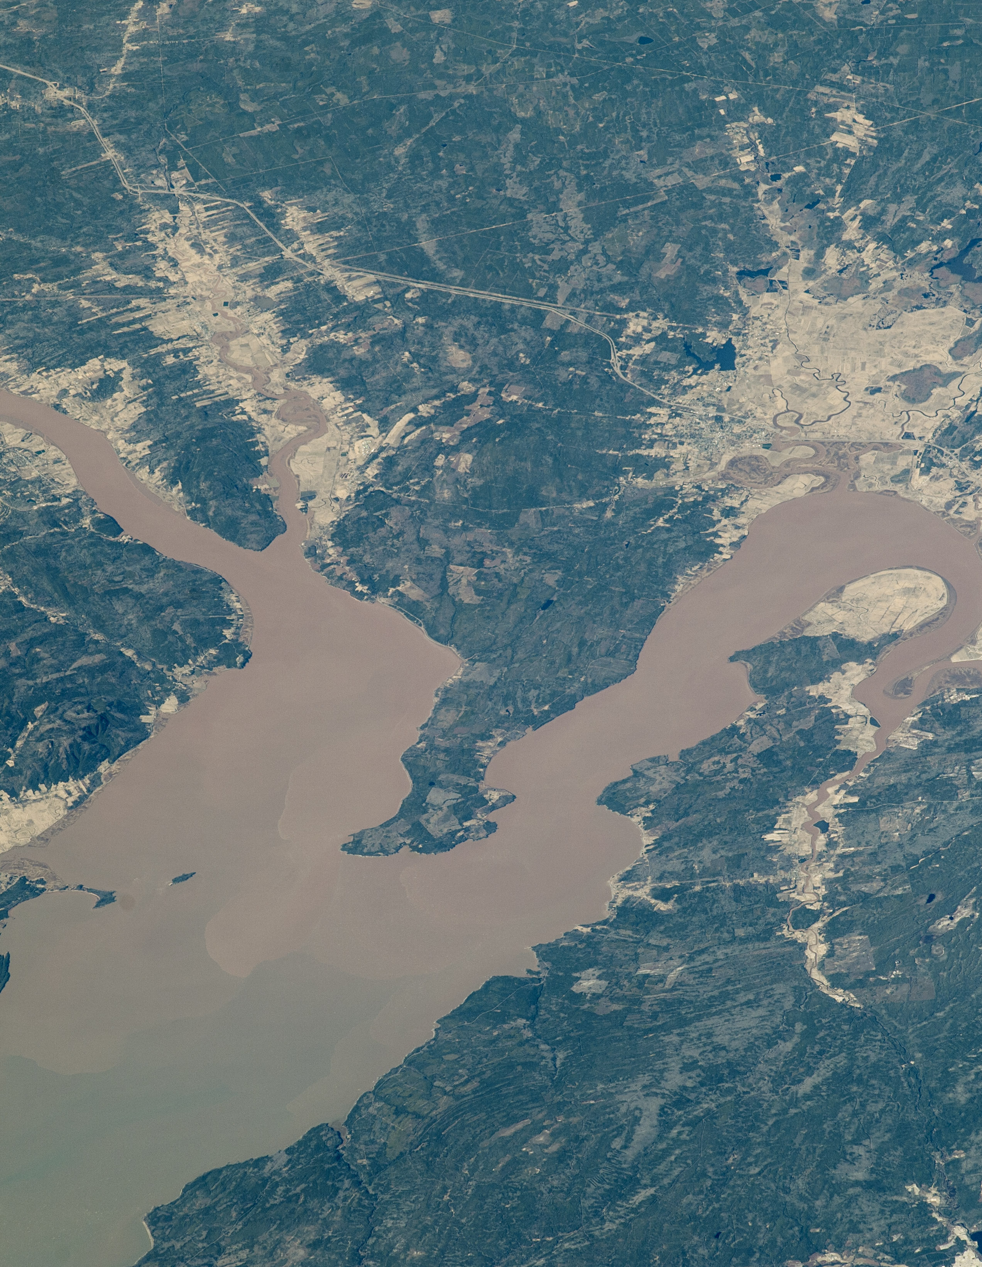
Motivations:
Goal: Examine how vertical migration of microphytobenthic (MPB) pennate diatoms (and other morphotypes) are controlled by tidal cycles, temperature and photoperiods
What is vertical migration?
Low Tide: Diatom cells accumulate on mudflat’s surface
Anticipation of High Tide: migrate downward into the sediment
^ Why? Efficient photosynthesis
Why did we study this phenomena?
Better understand diatoms in the Bay of Fundy
Learn about the possible impact of global warming
For application to satellite surveying of MPBs
Develop methods which can be applied to future studies
https://earthobservatory.nasa.gov/images/88305/bay-of-fundy
Notes:
The goal for our project was to examine how vertical migration of benthic diatoms are controlled by various conditions. Now you might be asking, what even is vertical migration? Vertical migration is a process by which diatoms migrate upward to the surface of the mud flats at low tide. They then migrate downward in anticipation of high tide. This process optimizes photosynthesis. We studied this phenomena to better understand the makeup of the Bay of Fundy and investigate the impacts of global warming. More broadly, to apply knowledge of this phenomena to satellite surveying of photosynthetic biomass and develop new methods of investigation.

Slide 4
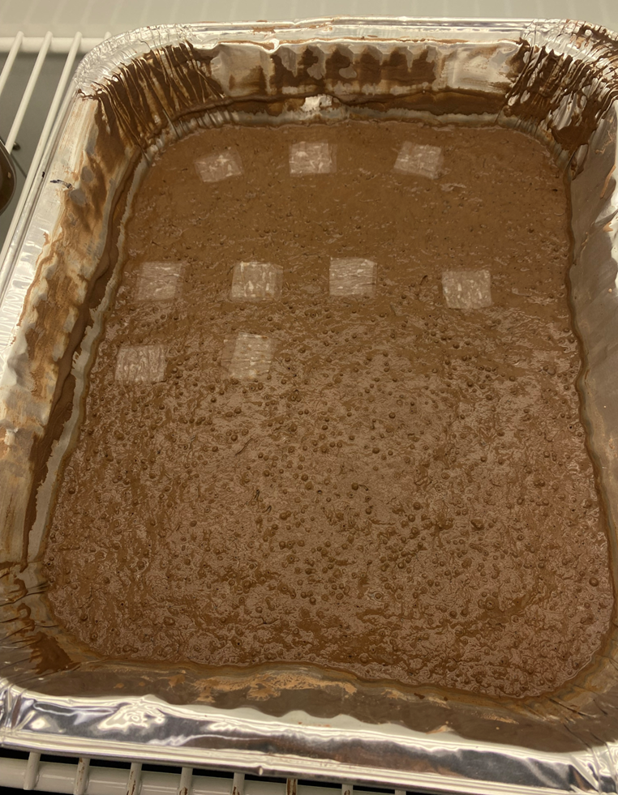
Methods
Mud collected from Peg's Cove, Bay of Fundy
Mud set up in lasagna pans
Mud incubated at 15°C, 20°C, and 23°C
Mud kept in same light level with a tin foil covering on one third and a mesh covering on another third
Lens paper in double layered strips added at 8:00

Slide 5
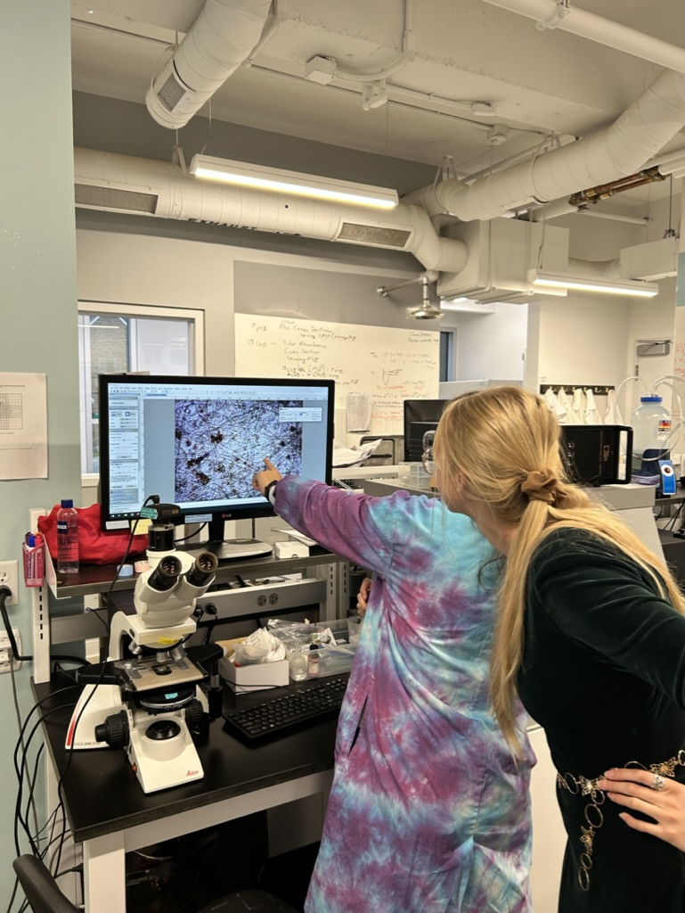
Community Composition
Goal: To better understand vertical migration by investigating the cell size and morphology.
Samples taken after 6hrs….
Lens paper mounted on slides
Fixed with Glutaraldehyde
Imaging using Florescent Scope
Used DMFs measure to analyze
Notes:
For the community composition analysis, I investigated vertical migration by cell size and morphology. For my samples, I took them off after a 6hr period, which represents a full tidal cycle. Lenses were mounted on slides individually and fixed with glutaraldehyde. I began by using light microscopy, but the mud resulted in too much interference. I then used the florescent scope to image slides. These images were analyzed using DMFmeasure.

Slide 6
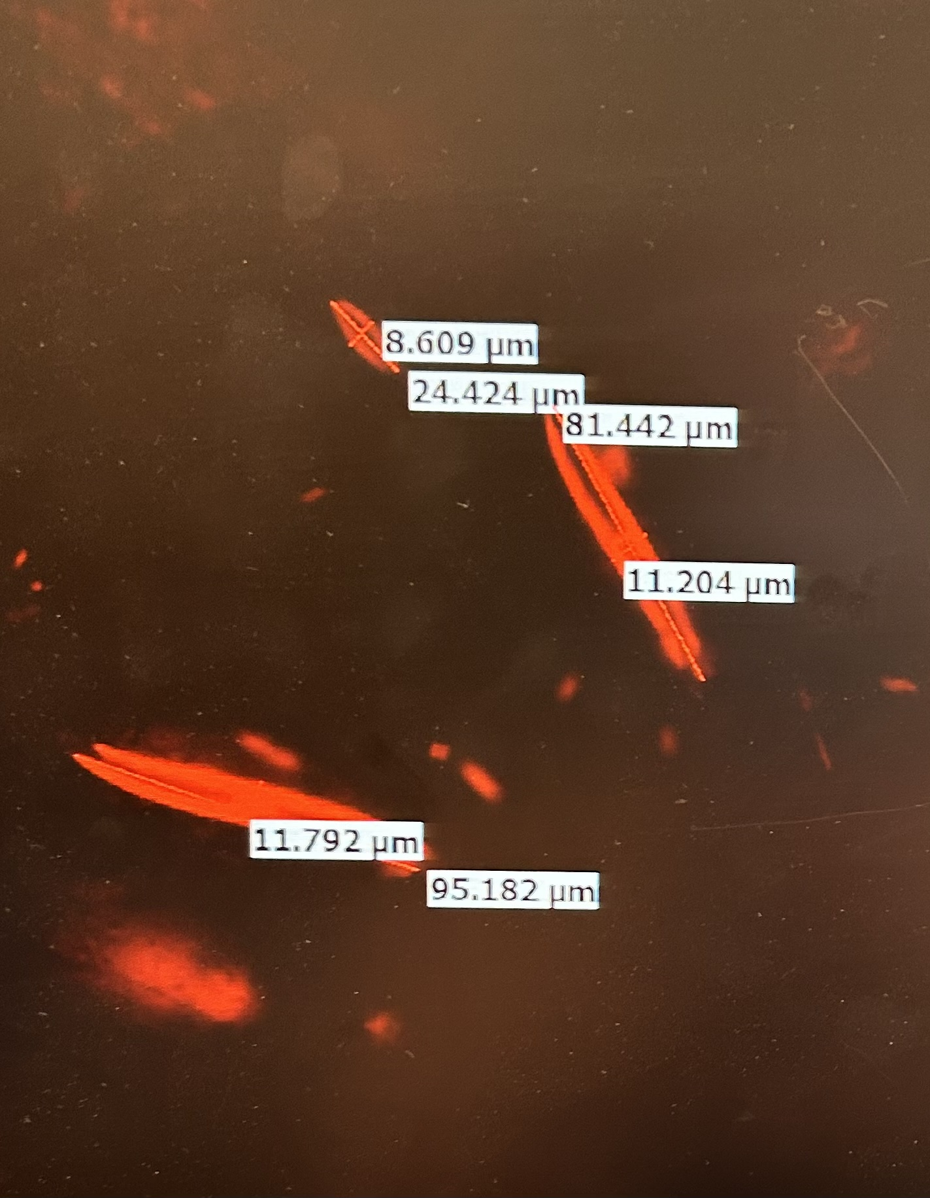
Community Composition
Focus…
ONLY 15°C and 20°C, light and dark
ONLY pennate and centric diatoms
Maximum dimension (largest measurement of either width or length)
Main interaction: Ratio between top and bottom layers
Why? Evidence of vertical migration
Notes:
For the analysis only some temperature conditions, 15 and 20, and two light levels, light and dark were used. I also only considered two morphotypes, pennate and centric, as they were the most common. Others were seen but either difficult to categorize or unable to measure all widths or the length. I used the maximum cell dimension to analyze the role of size. Maximum dimension refers to the largest measurement taken of the cell whether it’s a length or a widths. The main interaction I considered was the ratio between top and bottom samples.

Slide 7
Vertical Migration – Temperature
Goal: understanding patterns of vertical migration with increasing temperatures
Samples taken every hour (from 09:00 to 14:00)
Lens paper placed on test tubes
Treated with 2 mL of solvent (Acetone + DMSO)
Measured chlorophyll abundance in Chlorophyll Fluorometer
Sent to statistical analysis

Slide 8
Light and Temperature Vertical Migration
Goal: To determine if different light and temperature conditions influence vertical migration
Samples removed at 14:30
Lens paper placed on test tubes
Treated with 4 mL of solvent (Acetone + DMSO)
Measured chlorophyll abundance in Chlorophyll Fluorometer
Sent to statistical analysis

Slide 9
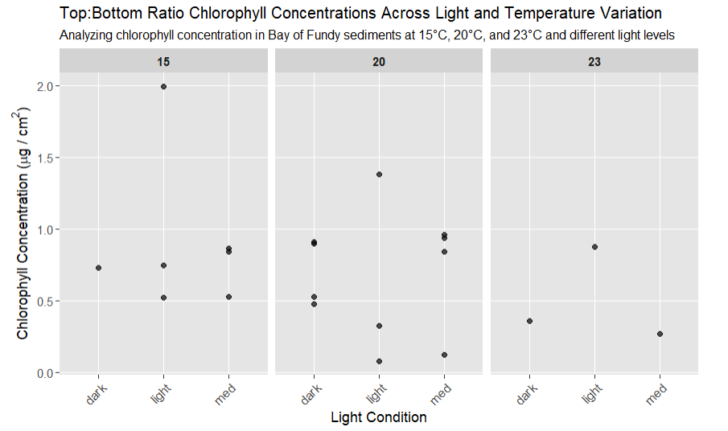
Result - Light and Temperature Vertical Migration
Top chlorophyll
Ratio
No statistical significance
Bottom chlorophyll

Slide 10
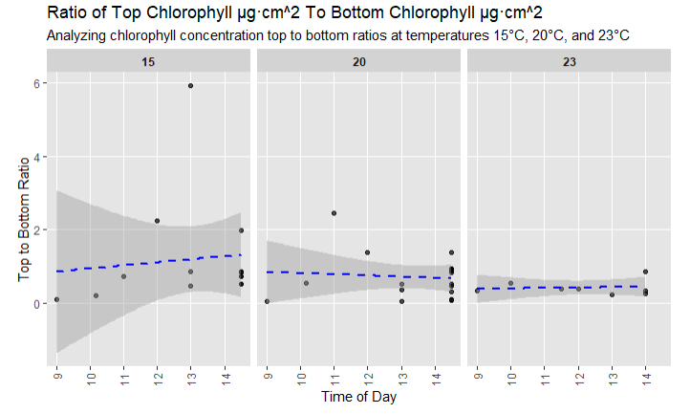
Results – Vertical Migration
P-value: 0.0711

Slide 11
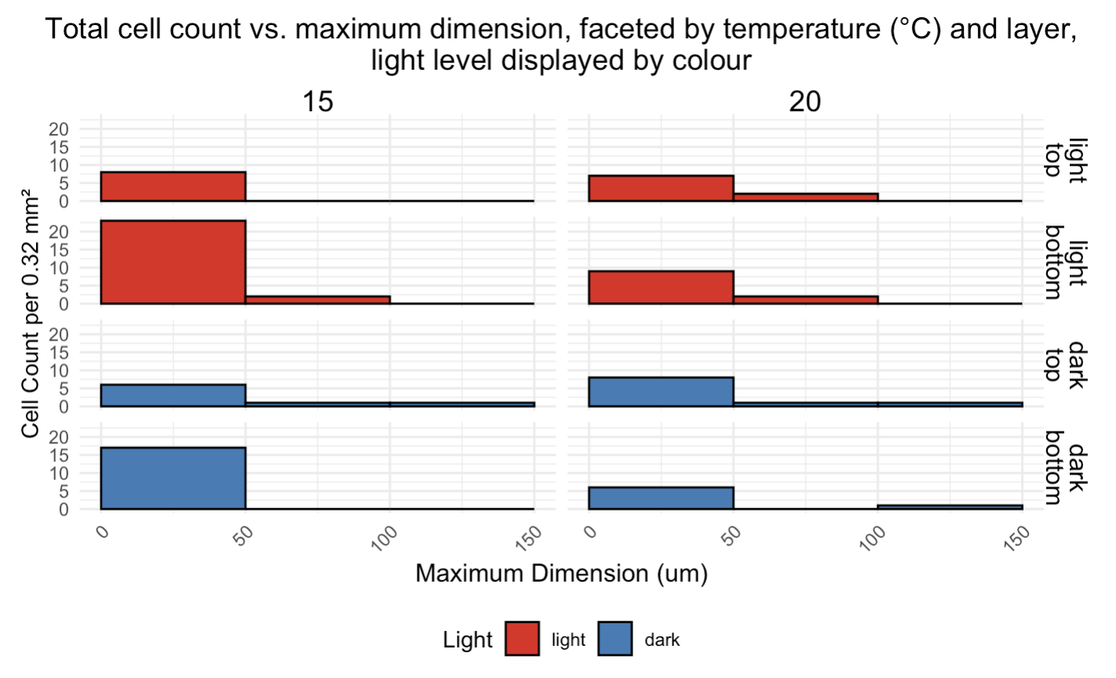
Result – Community Composition
What size diatoms are preforming vertical migration?
Notes:
For my first graph, I asked; what size diatoms are preforming vertical migration? On the y-axis you see a total cell count….

Slide 12
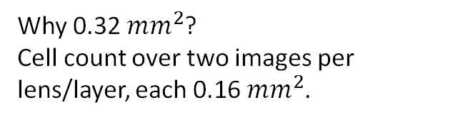
Result – Community Composition
TOP
1 cm x 1 cm
BOTTOM
Why 0.32 ${mm}^{2}$?
Cell count over two images per lens/layer, each 0.16 ${mm}^{2}$.
Notes:
… it represents a cell count per 0.32 mm2. 0.32 mm2 represents the area of two florescent scope images, as I took two pictures per lens. The x-axis features the maximum dimension binned every 50 um. This graph is faceted by temperature, 15 on the left and 20 on the right. On the right y-axis you can see facets paired layer and light condition. The top lenses are these ones (POINT), and the bottoms are these (POINT).

Slide 13
Result – Community Composition
What size diatoms are preforming vertical migration?
General Trend:
Majority of cells ≤ 50 um
Kimwipes pore size?
Notes:
The major trend seen in the data is an overwhelming majority of cells equal to or under 50um. This is true for both light conditions (POINT). Something else I observed is the discrepancy between cell counts on top and bottom samples at 15 degrees. More cells are found on the bottom layer.

Slide 14
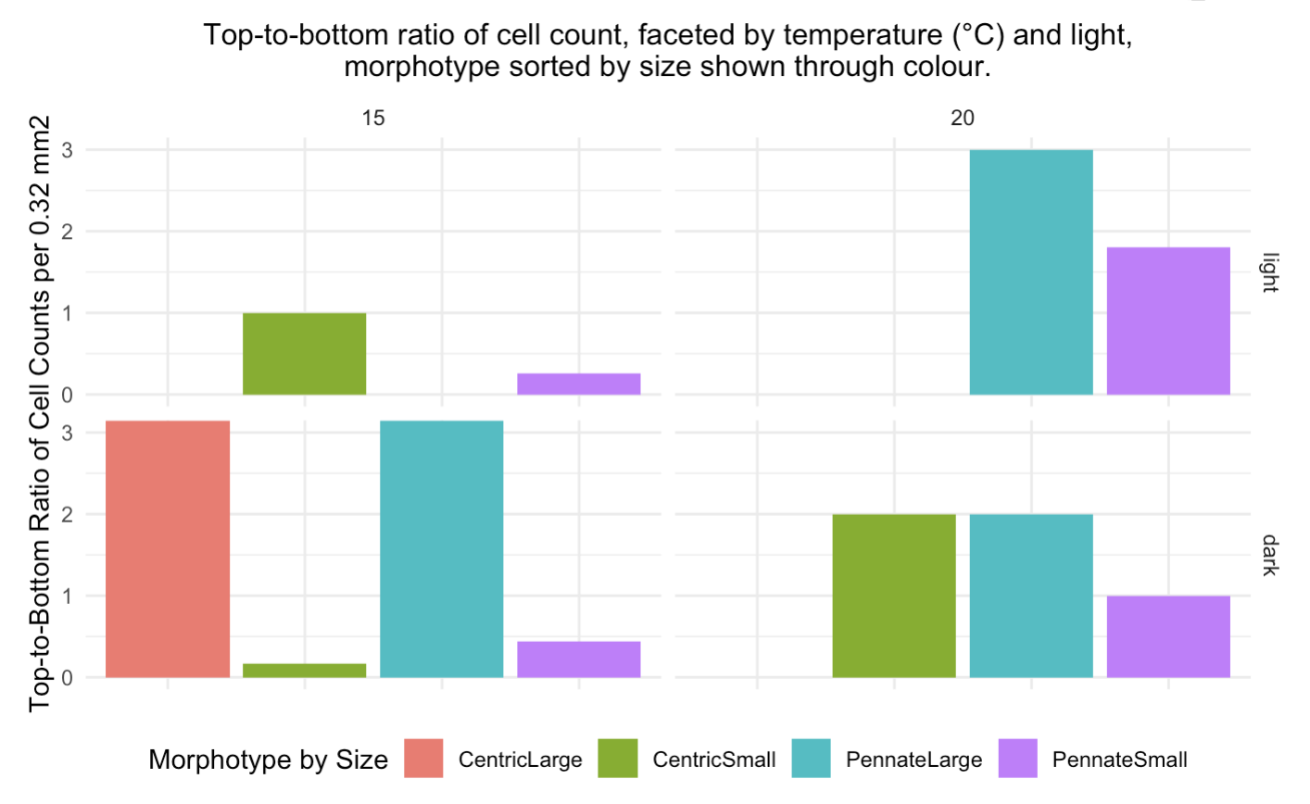
Result – Community Composition
How does morphotype and size vary across conditions?
Notes:
This is my second graph which investigated if morphology and size vary across conditions.

Slide 15
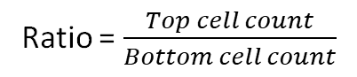
Result – Community Composition
Ratio = $\frac{Top cell count}{Bottom cell count}$
Centric large = centric diatoms with maximum dimensions > 50 um
Centric small = centric diatoms with maximum dimensions ≤ 50 um
Pennate large = pennate diatoms with maximum dimensions > 50 um
Pennate small = pennate diatoms with maximum dimensions ≤ 50 um
Notes:
On the x-axis is top-bottom ratio of cell counts. The ratio is created by dividing top cell counts by bottom cell counts. The figure is also faceted by temperature and light. Every cell was sorted into four categories. Centric Large, centric diatoms with a maximum dimension over 50 um and centric small, which constitute centric cells equal to or under 50 um. The same two categories exist for pennate (POINT). By looking at the figure you can see that the community composition varies between temperatures and light levels. For example, see centric large which is only present in one condition, dark at 15 degrees.

Slide 16

Result – Community Composition
Barely significant p-value:
temperature = 0.048
NOTE: working with small numbers of cells in each category
Notes:
Because of the visual differences between composition, I tested for significance with an ANOVA. A barley significant effect was seen with temperature. However, this was created with a small sample size so it was be may be giving a false impression.

Slide 17
Conclusion
Big Picture:
Chlorophyll levels:
Evidence that vertical migration did take place over every light (light, medium, dark) and temperature condition (15, 20, 23 degrees).
Some suggestion that temperature may have an effect, BUT not a significant.
Manual cell counting:
Significant effect of temperature on top-bottom ratios.
Majority of diatoms observed were equal to or below 50 um.

Slide 18
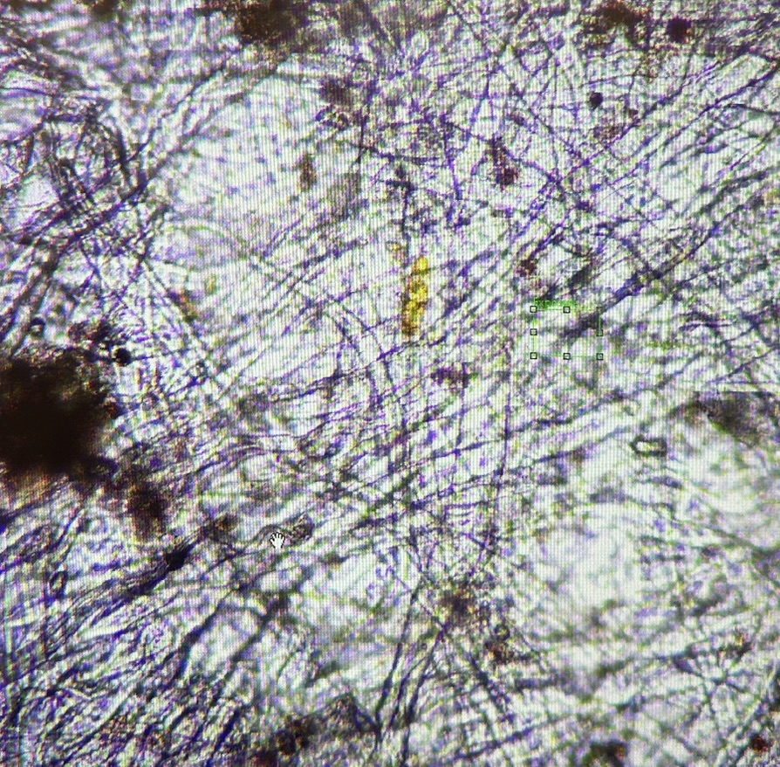
Thank you!

